Slide 1

on Google Play
What makes an app
Dave Fonorow, Thomas Knies, Lisa Reed-Preston, Sherrill Toran

Slide 2
Core Message
Mobile apps are in demand
They are becoming easier to make
There are many commonalities in successful apps

Slide 3
User Motivation
Users download apps for various purposes
complete a specific task
expand on a product or service
word-of-mouth (WOM)
Project focus: Users Opinion
Free vs Paid
Ratings vs Reviews
Installs vs Category

Slide 4
Where we looked
With a mutual interest in technology, we explored
kaggle.com
data.world
medium.com.

Slide 5
Our focus narrows
Selected Dataset
"Google Play Store Apps Web scraped data of 10k Play Store apps for analysing the Android market."
https://www.kaggle.com/lava18/google-play-store-apps
contains two datasets

Slide 6
What we looked at
What influences installs?
Cost: Free vs. Paid
Genre
Popularity of Android Version
Sentiment
Reviews
Ratings

Slide 7
Our Process
Dataset selected after group research and input
Questions occurred during research and were noted
Members selected questions they wanted to pursue
Each member worked to answer their own question
Members shared roadblocks and resources
Data interpretation happened in group conversation

Slide 8
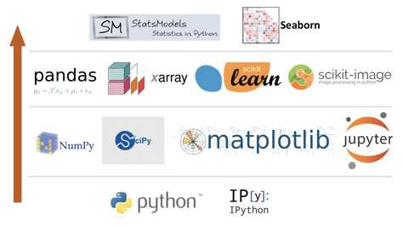

Packages Required
◦Python libraries used to analyze data
ØPandas
ØNumpy
ØMatplotlib
ØSeaborn
ØScipy
ØJupter

Slide 9
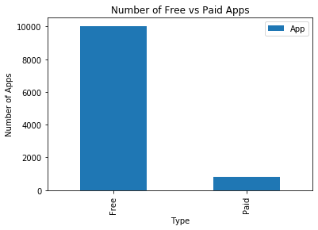

Free vs. Paid
What influences installs?

Slide 10
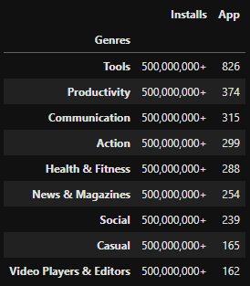
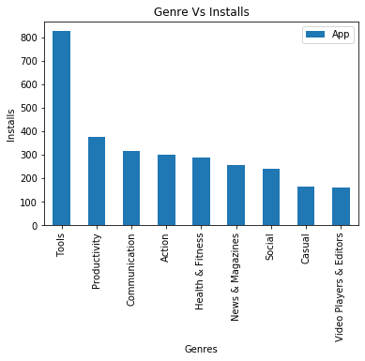
Genre Comparison
What influences installs?

Slide 11
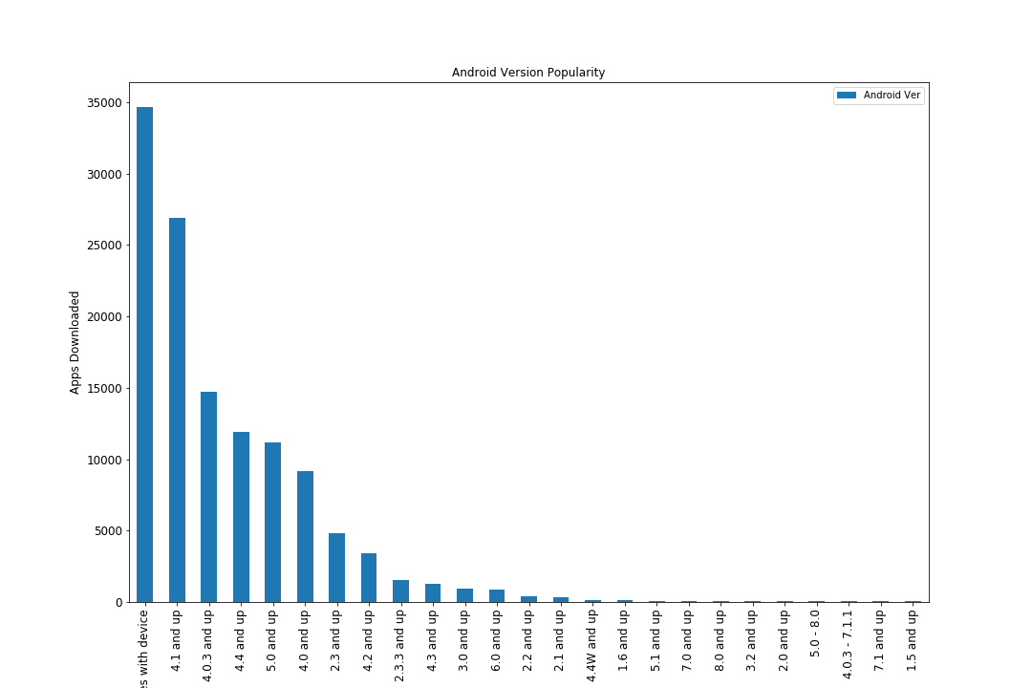
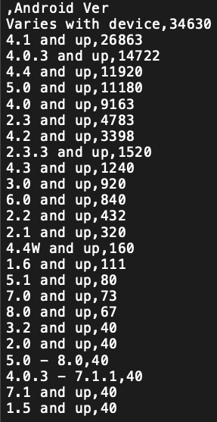
Popularity of Android Version

Slide 12
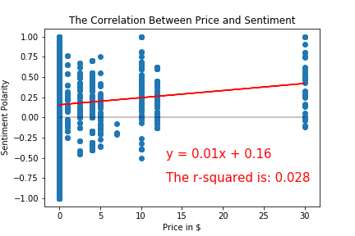
Sentiment

Slide 13
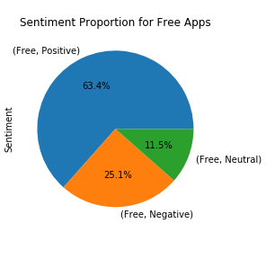
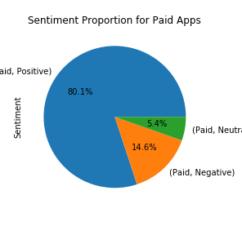
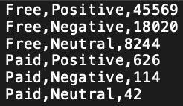
Sentiment

Slide 14
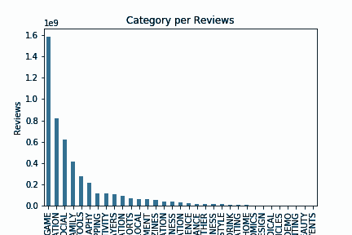
Reviews

Slide 15
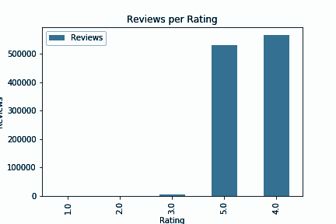
Ratings

Slide 16
Conclusion

Slide 17
What we found
Successful apps shared the following characteristics:
Free
Utility
Android Version 4.1 or higher

Slide 18
Additional Findings

Slide 19
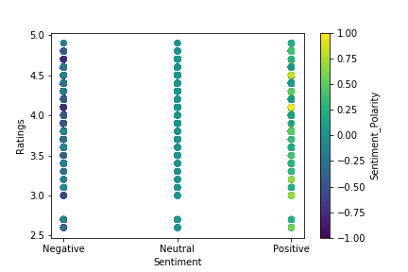
Sentiment
Sentiment Polarity does not vary much within the correlated sentiment.
Ratings from 2.5 - 5 had a broader range of sentiment than expected.

